Slide 1

CENSUS OPEN INNOVATION LABS
The Opportunity Project
Indigenous Communities
Focused Sprints Kick Off
August 29, 2024
Notes:
Oonugwito! Welcome and thank you for joining us!

Slide 2

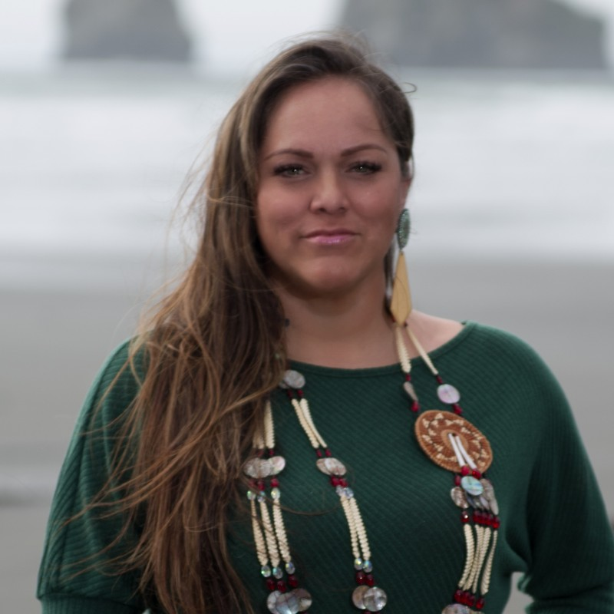

Meet the Sprint Leaders
Alaina Capoeman-Davis (Quinault)
Tribal Relations Specialist
Los Angeles Region
U.S. Census Bureau
Iris Friday (Tlingit)
Native American Program Specialist
U.S. Department of Housing and Urban Development
Notes:
Hinch Xoputsee, toolthchalth kwinailth. I’m Alaina Capoeman, citizen of Quinault Nation and the co-leader of this sprint. I started with the Census during the decennial in 2010 I returned for 2020. The Tribal Relations Program became a permanent program in 2021. There are four of us, I cover Alaska, Washington, Idaho, Oregon, Nevada, California and Hawaii. I am proud to co-lead with the fabulous Iris Friday. Iris please introduce yourself.

Slide 3


Meet the Opportunity Project Team
Dominica Zhu
Head of Human Centered Innovation
Advisor, Indigenous Peoples
Census Open Innovation Labs
U.S. Census Bureau
Thera Naiman
Innovation Program Manager
Census Open Innovation Labs
U.S. Census Bureau
Notes:
I want to hold up two amazing women that have been helping us navigate this process. They are very responsive and helpful team members of the TOP. Dominica, please introduce yourself. Thera, please introduce yourself.

Slide 4
THE OPPORTUNITY PROJECT (TOP)
Brings together technologists, government, and communities to rapidly prototype digital products—powered by federal open data—that solve real-world problems for people across the country.

Slide 5
IN 8 YEARS AND 20+ SPRINT CYCLES…
230+ digital products
tackling challenges like ocean plastic pollution, workforce development, entrepreneurship, COVID-19, disaster response, rural development, & more.
30+ federal agencies engaged
30+ universities 350+ datasets
3000+ stakeholders from outside of government
$400k+ in prizes awarded 8 showcase events
Notes:
The Opportunity Project has been around more than 8 years now, more than 20 Sprint cycles, and we'll talk in a bit about what a sprint is. We've catalyzed the development of over 230 digital products which range from apps to maps to data visualizations, and AI algorithms and toolkits and more. We've worked with over 25 federal agencies, as well as some cities and NGOs, and we'll talk a little bit more about that. We, our participants have used over 350 open datasets we've engaged over 3000 stakeholders from outside of government Those include tech companies, nonprofits, universities, think tanks, and many others. And we through price competitions using America Competes authority has has given out over $400,000 in prizes over the last couple of years. And then we've showcased all of our work through six Demo days, two of which were demo week, or as last year, we called summit and we'll talk a little bit more about all of that in just a moment.

Slide 6





















PAST PARTICIPANTS

Slide 7
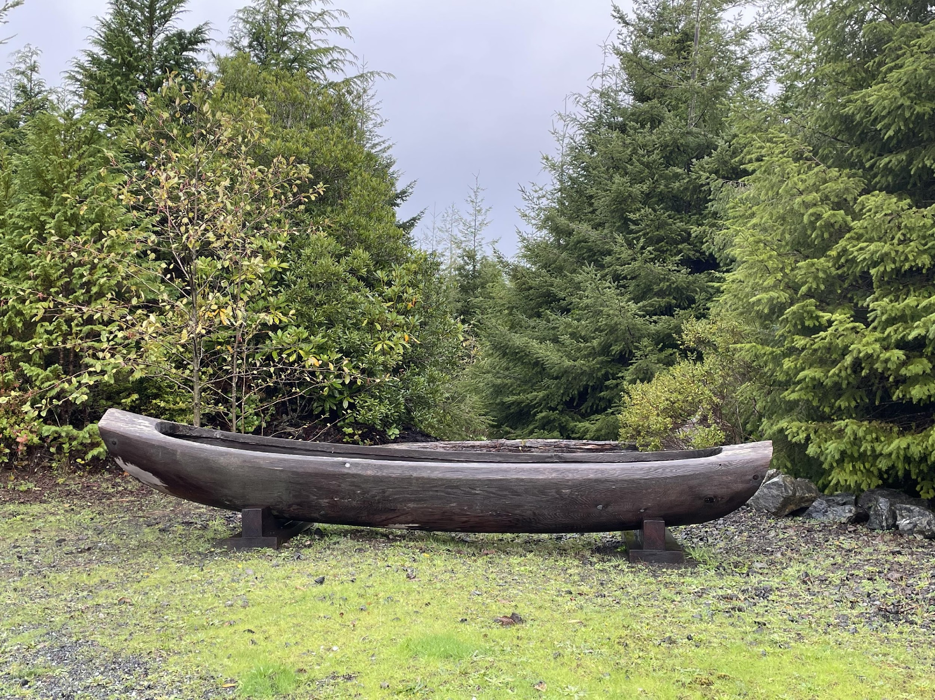
Haley
The Sprint Process
Notes:
So now we’ll move on to just share some background on the Opportunity Project how it works.

Slide 8
THE SPRINT PROCESS
Problem Statement Development
Federal agencies, local governments & NGOs develop problem statements
Youth homelessness (ED)
Civics Education (State)
Advancing Entrepreneurship (EDA)
The Opioid Crisis (OSTP)
Digital economy (Coral Gables, FL)
Transportation Emissions (EPA)
Economic Self-Sufficiency (HUD)
COVID-19 (HHS)
Disaster Response (FEMA)
Apprenticeships (DOL)
Notes:
Through the TOP process, federal agencies identify national challenges in need of data-driven innovation. You just heard a bit about our upcoming 2024 topics, which we’re very excited about. In the past these challenges have also included environmental challenges (like helping the public understand the effects of transportation emissions on air quality and helath, or reducing plastic pollution), sustainable rural economic development, gov’t spending as it relates to COVID-19, civics education and the use of evidence-based examples that help students increase their data literacy, disaster response, supporting refugees, and more.

Slide 9




THE SPRINT PROCESS
Recruit Teams to Build Solutions
To address these challenges, sprint participants are identified representing diverse roles and expertise.
Tech/Product Teams
User Advocates
Data Stewards
Product Advisors
Notes:
A key component of the TOP process is that we bring together a kind of a coalition of cross sector collaborators that support the tech teams (which we also sometimes call product teams, for problem statements that lend themselves to non-digital tools as well). The product teams are the ones that are building the solution to the identified problem. So we build this coalition of experts to really accelerate their progress through a very human centered approach. This coalition includes the federal agency policy experts who are the ones that identified these problem areas; federal data stewards, who answer questions about the data and help the teams to identify other relevant datasets, and then user advocates who represent the communities and potential end users that would be utilizing these products. We also bring on product advisors from outside of government who can help the teams to really think about the longer term sustainability and longevity of their products. So that's the broad overview of the cross sector collaboration that takes place within the TOP methodology.

Slide 10
THE SPRINT PROCESS
Sprint Milestones
All participants collaborate through milestones, which structure the sprint over
12 weeks.
Data
Exploration
Concept
Pitch
Beta
Demo
Product Sustainability Milestone
MVP
Demo
User
Research
Launch at
Summit
Notes:
This is how the timeline works for an Opportunity Project sprint. This is going to be a 12 to 14 week sprint cycle. And it's broken up into seven components, the first being user research. So before any sort of concept is designed, we're emphasizing a very human centered approach where the product teams are consulting with different user advocates, who represent the potential end users, to understand what might be the best potential product outcomes. So user research is the primary step. From there it goes into data exploration, which entails understanding the datasets that will empower and respond to these pressing challenges and ultimately be integrated into the product. Next is the concept pitch where the teams are pitching their concept to the rest of the cohort and after that is the beta demo. Next up is the product sustainability milestone where teams have the opportunity to work with product advisors to develop a sustainability and longevity plan. Next is an MVP demo which is the product in its minimum viability form. And then finally, products will launch at Census Open Innovation Summit.

Slide 11
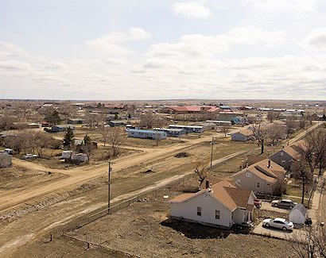
AFTER THE SPRINT
MAINTAIN
SUBMIT
Products are owned and maintained by the teams who built them.
Certain years, teams can choose to submit their product in
our prize competition.
PROCURE
Agencies can choose to engage further with teams via contract/
procurement, but not expected.
Fort Belknap
Notes:
So after the sprint, these products are owned and maintained by the teams that build them. That is a very crucial identifier that we at the Census Bureau or any of the federal agencies involved are not seeking these to be necessarily contracted or prodcured. The agencies can choose to engage further with these teams, but these teams are owning and operating these products for the long term. They are simply leveraging this methodology through the Opportunity Project through the Census Bureau to identify a problem and work towards finding solutions to these problems so that solutions can be more widespread and accessible to the American people . Teams can choose to submit their products in a prize competition that leverages the America Competes authority. We will be doing that likely on a biannual basis basis. So every other year, teams will be open to submit their product for a federal prize. And then agencies can of course choose to engage further for contractor procurement, but that is not expected from the onset of this process. So to quickly reiterate that: the goal of the Opportunity Project is really not to develop products for federal government. It's truly to develop products and solutions for communities and different groups outside of government. So we just want to make sure you know that we're very transparent about that. It's really not intended to be a sales pitch for government or a business development opportunity to directly receive a contract from participating. It is, however, an awesome opportunity to build partnerships and make connections with folks both within government and within the nonprofit space and with other tech companies and other organizations. But again just wanted to be really transparent that it's really not intended to be a contract mechanism or procurement mechanism for folks in the private sector.

Slide 12
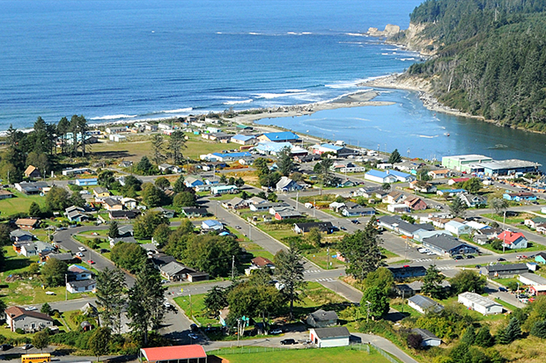
Sprint Timeline
Notes:
I'll share a little bit more about how to get involved and we will have a q&a session at the end so please feel free to just received your questions and and then we will hopefully get to all of them and if not, we'll provide our email so you can get in touch with us.

Slide 13
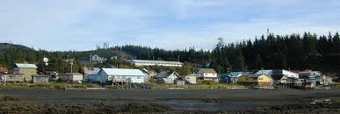
Project Background
Notes:
I'll share a little bit more about how to get involved and we will have a q&a session at the end so please feel free to just received your questions and and then we will hopefully get to all of them and if not, we'll provide our email so you can get in touch with us.

Slide 14
THE GOAL
Create tools that will improve and enhance access to homeownership and housing stability for American Indian and Alaska Native (AIAN) populations and Indigenous communities, particularly on reservations and/or other tribal areas.
THE OPPORTUNITY
The creation of user-friendly tools and analyses will foster housing access and stability for Native American communities, particularly on reservations and in other tribal areas. Tools could involve consolidating resources, streamlining networks of contacts, or bolstering traditional methods of housing the community. We would like to create a coalition that will continue this work after the sprint.
Notes:
Through the TOP process, federal agencies identify national challenges in need of data-driven innovation. You just heard a bit about our upcoming 2024 topics, which we’re very excited about. In the past these challenges have also included environmental challenges (like helping the public understand the effects of transportation emissions on air quality and helath, or reducing plastic pollution), sustainable rural economic development, gov’t spending as it relates to COVID-19, civics education and the use of evidence-based examples that help students increase their data literacy, disaster response, supporting refugees, and more.

Slide 15
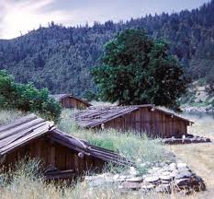
Introductions
Notes:
I'll share a little bit more about how to get involved and we will have a q&a session at the end so please feel free to just received your questions and and then we will hopefully get to all of them and if not, we'll provide our email so you can get in touch with us.

Slide 16
PRODUCT/TECH TEAMS
Native Reach
Ron Mori
Beth Forest
Ideation Colab
DJ Lampitt
Tribal Nations Research Group
Anita Frederick

Slide 17
USER ADVOCATES
Scott Pinkham (United Indians of All Tribes Foundation)
Gemma Lockhart (Open Road Pictures)
Charles Anderson (Northwest Indian Housing Authority)
Melissa Bruce (U.S. Census Bureau)
James Tucker (Natives Count Coalition)
Kevin Klingbell (Big Water Consulting)
Twila Martin Kekahbah (TMK Contracting)
William Picotte (Peacock Consulting)
Dr. Collette Adamsen (University of North Dakota)
Dave Castillo (Native Community Capital)
Douglas Marconi (National American Indian Housing Council)
Blythe McWhirter (National American Indian Housing Council)
Melody Dawe (Federal Home Loan Bank of Des Moines)
Ryan Stopper (Chief Seattle Club)
Dee Alexander (U.S. Census Bureau)
Mariah Ralston (Quinault Housing Authority)
NaDaizja Bolling (Aquinnah Cultural Center)
Sierra Campbell (United Indians of All Tribes Foundation)
Tony Barbero (United Indians of All Tribes Foundation)
Notes:
Introductions

Slide 18
User Research
This is an essential part of the sprint where tech/product teams speak with our user advocates to understand how to approach this problem, understand nuances, and start to brainstorm useful solutions with user advocates.
Goal: To understand the user advocates backgrounds, experience, perspectives on the challenge
For example:
  Tech teams can convene multiple user advocates on at once on group calls
  Tech teams can schedule 1:1s with user advocate groups
Notes:
Through the TOP process, federal agencies identify national challenges in need of data-driven innovation. You just heard a bit about our upcoming 2024 topics, which we’re very excited about. In the past these challenges have also included environmental challenges (like helping the public understand the effects of transportation emissions on air quality and helath, or reducing plastic pollution), sustainable rural economic development, gov’t spending as it relates to COVID-19, civics education and the use of evidence-based examples that help students increase their data literacy, disaster response, supporting refugees, and more.

Slide 19
Questions to Explore (examples)
How does this problem affect your community?
What are the major pain points about this challenge?
What is an overlooked aspect of this challenge that needs addressing?
How has technology been helpful or harmful?
What should the tech/product teams caution against in building out a tool?
What would be extremely helpful in addressing this challenge?
What are the blindspots that need to be understood about this challenge?
What would be an ideal tool to be created?
Notes:
Through the TOP process, federal agencies identify national challenges in need of data-driven innovation. You just heard a bit about our upcoming 2024 topics, which we’re very excited about. In the past these challenges have also included environmental challenges (like helping the public understand the effects of transportation emissions on air quality and helath, or reducing plastic pollution), sustainable rural economic development, gov’t spending as it relates to COVID-19, civics education and the use of evidence-based examples that help students increase their data literacy, disaster response, supporting refugees, and more.

Slide 20
NEXT STEPS
Each week, keep your eyes peeled for an email from the sprint leaders laying out the goals for the week.
Tech teams should start reaching out to user advocates and setting up user research calls to learn about their experiences and needs on the ground. Tech teams should connect with at minimum 3 user advocate groups over the next two weeks.
On the User Research Milestone on September 19th, tech teams will present their findings from user research to the whole cohort.
User advocate conversations with tech teams should be ongoing throughout the sprint.
Notes:
Through the TOP process, federal agencies identify national challenges in need of data-driven innovation. You just heard a bit about our upcoming 2024 topics, which we’re very excited about. In the past these challenges have also included environmental challenges (like helping the public understand the effects of transportation emissions on air quality and helath, or reducing plastic pollution), sustainable rural economic development, gov’t spending as it relates to COVID-19, civics education and the use of evidence-based examples that help students increase their data literacy, disaster response, supporting refugees, and more.

Slide 21
SPRINT TIMELINE
August 29th | Kick Off Call: teams meet for a soft launch, intros to sprint leaders and other participants, dive into sprint topic
September 19th | User Research Milestone: teams gather to share user research progress
October 3rd | Data Exploration: teams gather for a data Q&A session
October 17th | Concept Pitch Sessions: teams present the initial concept for their sprint products
October 31st | Beta Demos: teams share more mature versions of their product for feedback
Week of November 11th or 18th | MVP Demos: teams present the complete Minimum Viable Product they have created in the sprint
TBD (December 2024 or early 2025) | Summit: Products launch at a public-facing, open-press event

Slide 22
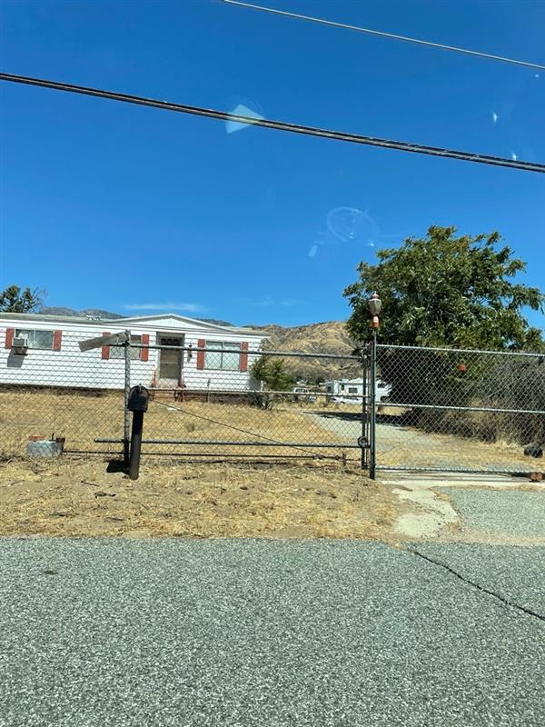
Discussion
Notes:
Take notes!

